Slide 1
XMC4500 USB Host Mass Storage Example
Getting Started V1.0

Slide 2
Contents
1
Overview
2
Requirements
3
Setup
4
Implementing the application
5
How to test
6
Debug hints
7
Further reading
8
Limitations

Slide 3
Contents
1
Overview
2
Requirements
3
Setup
4
Implementing the application
5
How to test
6
Debug hints
7
Further reading
8
Limitations

Slide 4
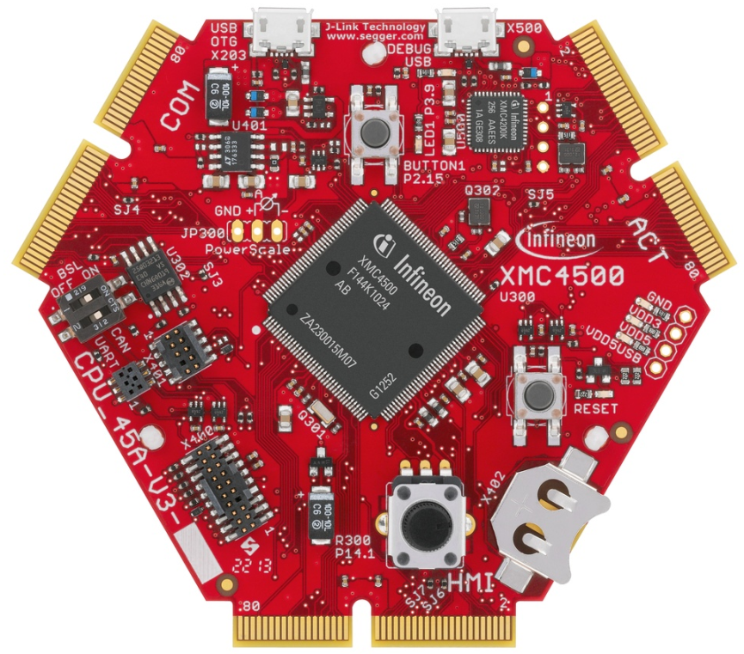
Overview
This example demonstrates the implementation of USB host mass storage functionality. It is based on the free LUFA USB host stack implementation which is ported to XMC4500 family and provided within this example.
Within this documentation you will be guided through all the building blocks of a typical USB host mass storage application on the XMC4500 family. You will be able to connect a USB flash drive device supporting the FAT file system to the host and perform file read and write access to the device.
As a result you will be enabled to implement your own USB host mass storage functionality on the XMC4500 family.

Slide 5
Contents
1
Overview
2
Requirements
3
Setup
4
Implementing the application
5
How to test
6
Debug hints
7
Further reading
8
Limitations

Slide 6

Requirements - hardware
XMC4500 General Purpose board CPU_45A-V3
USB cable micro-A plug to standard-A receptacle for host example
USB cable micro-B plug to standard-A plug for debugging
USB flash drive
Micro-A plug
Std-A receptacle
Micro-B plug
Std-A plug
Flash Drive

Slide 7
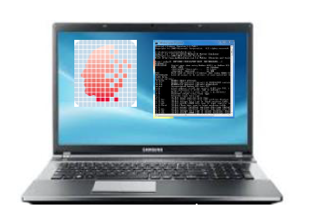

Requirements – hardware & software
Windows laptop
DAVETM installed
DAVETM (v4.1.4 or Higher)
Download DAVETM free of charge
Link : DAVETM v4 Download
July 2016
Copyright © Infineon Technologies AG 2016. All rights reserved.
7

Slide 8
Contents
1
Overview
2
Requirements
3
Setup
4
Implementing the application
5
How to test
6
Debug hints
7
Further reading
8
Limitations

Slide 9

Setup - hardware
Std-A receptacle
Flash Drive
Micro-A plug
Micro-B plug
Windows laptop running DAVETM
Std-A plug
Ensure proper cable types
Connect cables to the correct ports

Slide 10
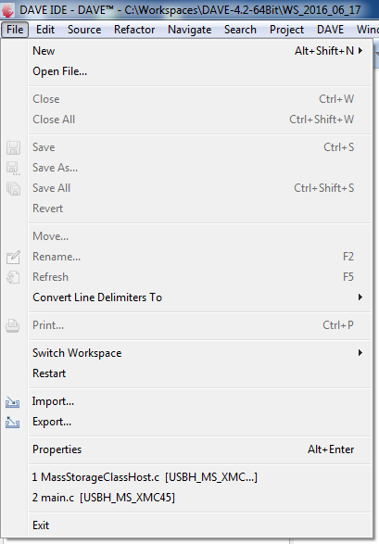
Setup – import example project in to DAVETM
1

Slide 11
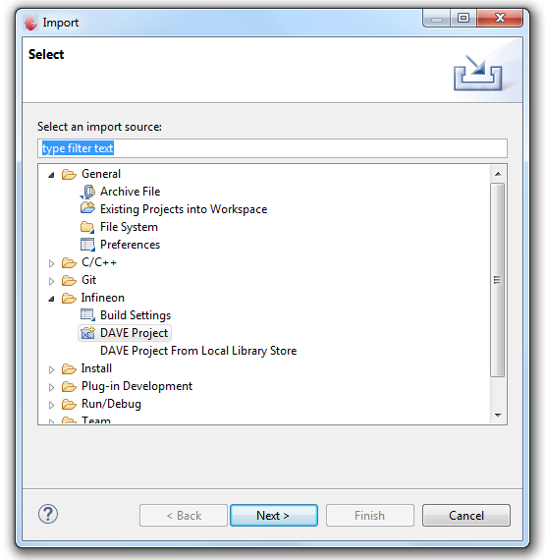
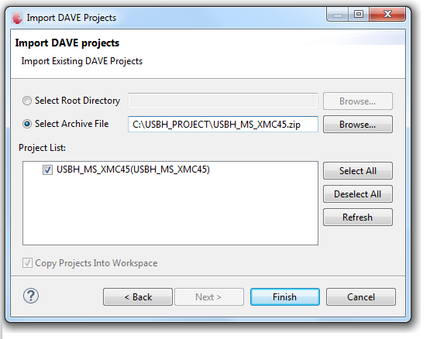
Setup – import example project in to DAVETM
2
3

Slide 12
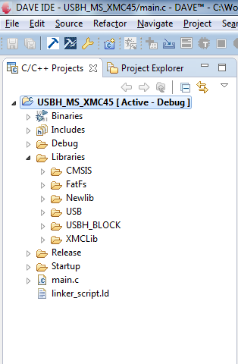
Setup – import example project in to DAVETM
Check the folder structure of the imported project.
1
Free FAT file system code
1
2
Free LUFA USB stack, mass storage class and glue layer for XMC low level driver
3
3
Code linking FAT file system and USB mass storage layer
4
XMCLib folder contains USB low level driver in file xmc_usb.c
2
4
5
5
The main file implementing the application

Slide 13
Contents
1
Overview
2
Requirements
3
Setup
4
Implementing the application
5
How to test
6
Debug hints
7
Further reading
8
Limitations

Slide 14
Example application behavior
XMC4500 General Purpose board is initialized as a USB host and provides VBUS on the USB port
When a USB flash drive is connected, LED1 (on P3.9) is turned ON after device is successfully enumerated
Host application creates a folder with the name ABSTEP and it creates 3 files, of sizes 1 KB, 2KB and 3KB using File IO calls.
The files are read back and compared. LED blinks continuously if comparison is successful, else it stays ON continuously
When USB flash drive is disconnected, LED1 is turned off

Slide 15
Simplified example application architecture
Application software
File I/O API
FAT file system
Block device API
SCSI protocol +
host mass storage bulk only transport +
host core stack
Low level driver based on USB host CMSIS API
USB host low level driver (XMCLib)
USB controller
FAT file system is based on a freely available implementation
USB stack and mass storage class implementation is based on a freely available stack known as LUFA

Slide 16
Example application data flow
Application software launches a file IO request using FAT file IO API
FAT file system converts the file IO calls in to block device calls.
Blocks are read and written using the standard SCSI commands and the mass storage bulk only transport protocol state machine
Data is transferred to/from USB mass storage device using low level driver APIs
Application software
FAT file system
SCSI protocol +
host mass storage bulk only transport +
host core stack
USB host low level driver (XMCLib)
USB controller

Slide 17
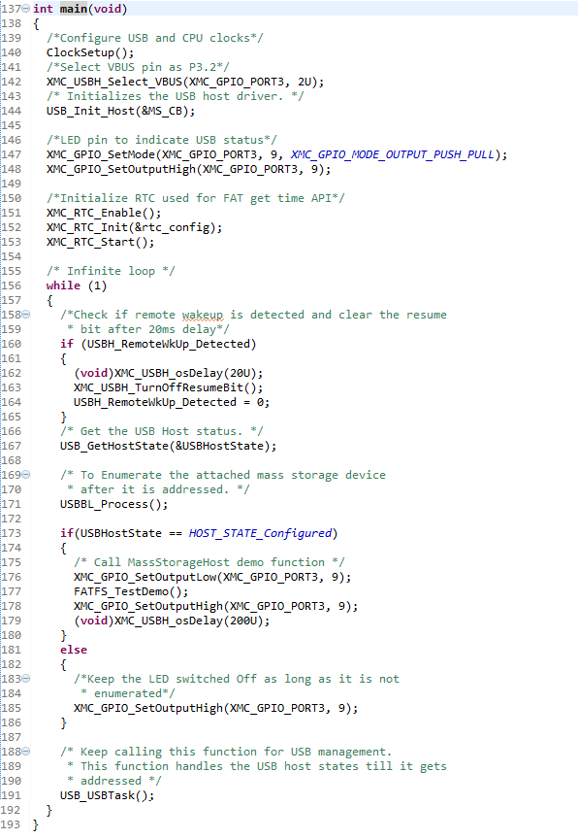
Application – overview of main.c
1
1
Clock setup for XMC4500
2
2
Select VBUS pin P3.2
3
3
Initialize USB host
4
Fetch descriptors and match it to mass storage device
4
5
5
Demo application function
6
Manage connection events and initiate enumeration
6

Slide 18
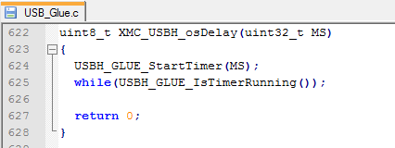
Application – configure time delay API
The USB stack uses timing delay of the order of several tens of milliseconds to comply with the specification
Port the time delay API if required. In the example code, the SysTick timer is used.
Ensure timer is calibrated

Slide 19
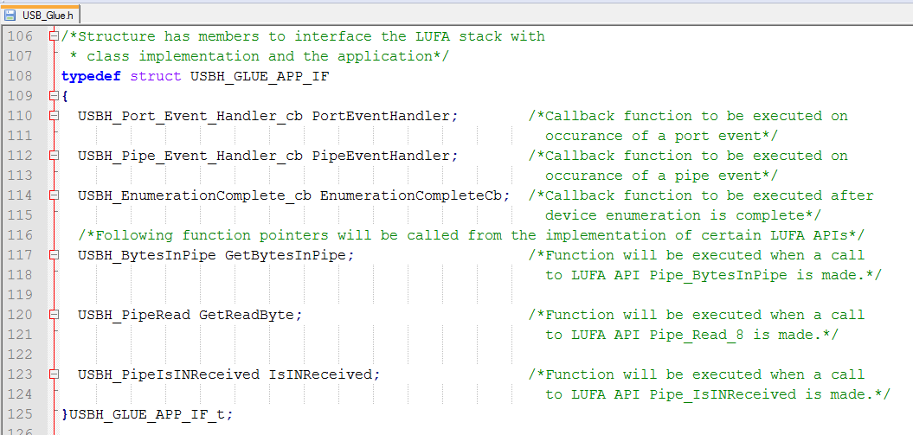
Application - callbacks
Application registers for the following event callbacks

Slide 20
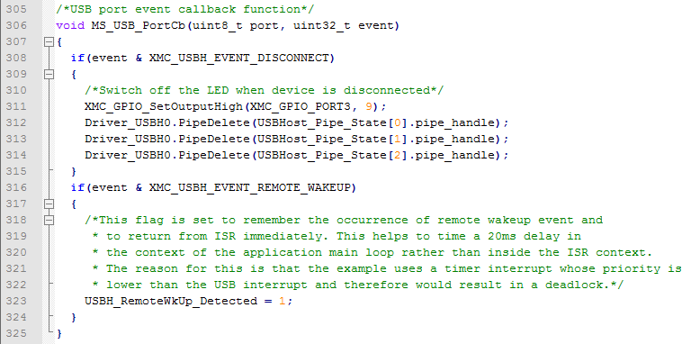
Application – Implement and register required callbacks
1
Implement call back function
1

Slide 21
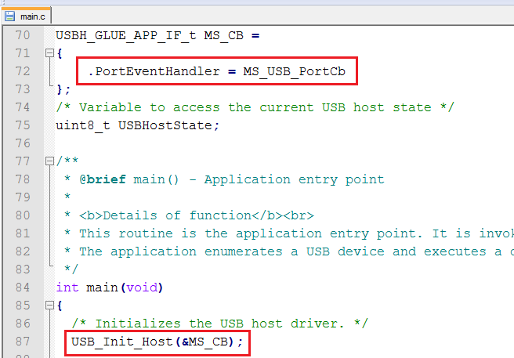
Application – Implement and register required callbacks
2
2
Register call back function
3
Call initialization function
3

Slide 22
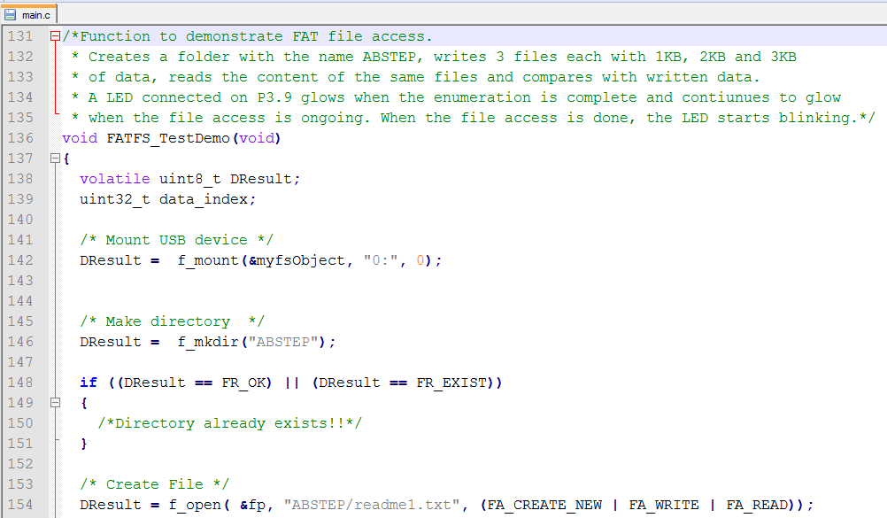
Application – file transfer demo
File I/O APIs are called to transfer files between host and device
Function FATFS_TestDemo() demonstrates file accesses

Slide 23
Contents
1
Overview
2
Requirements
3
Setup
4
Implementing the application
5
How to test
6
Debug hints
7
Further reading
8
Limitations

Slide 24
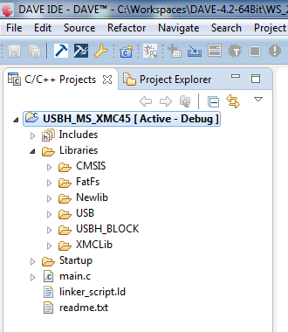
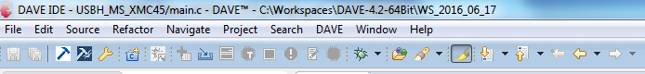
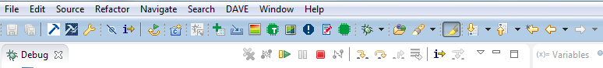
How to test
1
Build and download project into XMC4500 General Purpose board
2
Start
debugger
1
3
Start the execution by
pressing the run button
2
3

Slide 25
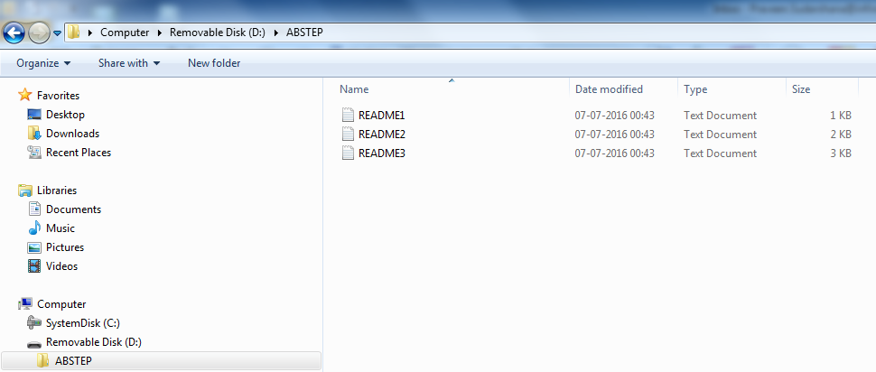
Example application behavior
Disconnect the USB flash drive and connect to a Windows laptop to confirm presence of files.

Slide 26
Contents
1
Overview
2
Requirements
3
Setup
4
Implementing the application
5
How to test
6
Debug hints
7
Further reading
8
Limitations

Slide 27
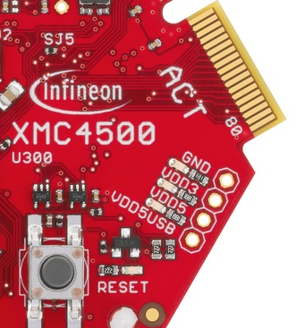
Debug Hints
Check VBUS is available and within permissible range (4.4V to 5.25V) on the USB host port receptacle. Lower VBUS voltages due to excessive current draw may cause USB devices to disconnect intermittently or fail enumeration. Try connecting a different USB device.
Long cables may cause malfunction due to signal quality issues. Use short cables if possible.
Test Point

Slide 28
Contents
1
Overview
2
Requirements
3
Setup
4
Implementing the application
5
How to test
6
Debug hints
7
Further reading
8
Limitations

Slide 29
Further reading
USB specifications and Micro-USB cables and connectors specification
http://www.usb.org/developers/docs/usb20_docs/
Mass storage class specifications
Mass storage class specification overview
Mass storage class bulk only
http://www.usb.org/developers/docs/devclass_docs/
SCSI specifications
www.t10.org
CMSIS USB host API specification
https://www.keil.com/pack/doc/CMSIS/Driver/html/group__usb__interface__gr.html

Slide 30
Further reading
FAT file system
http://elm-chan.org/fsw/ff/00index_e.html
LUFA USB stack
http://www.fourwalledcubicle.com/index.php
Books
USB Complete: The Developer's Guide, Jan Axelson
USB Mass Storage: Designing and Programming Devices and Embedded Hosts, Jan Axelson

Slide 31
Contents
1
Overview
2
Requirements
3
Setup
4
Implementing the application
5
How to test
6
Debug hints
7
Further reading
8
Limitations

Slide 32
Limitations
FAT File system supports only short file names i.e. in 8.3 format.
USB Hubs are not supported
Over current protection is not supported
DMA Transfers are not supported
Low level driver does not support isochronous transfers

